Slide 1
Acid Rain

Slide 2
A brief introduction
https://www.youtube.com/watch?v=v09KnqiYi-c

Slide 3
What is it?
Robert Angus Smith, an English chemist, first used the phrase "acid rain" in 1852
He noted the connection between London's polluted skies and the acidity of its rainfall.
Refers to a mixture of materials in the atmosphere containing higher than normal amounts of nitric and sulfuric acids.

Slide 4
Cont.
Most acid rain has a pH of about 4.3, compared to a “normal” 5.6.
Can come from natural sources
Volcanoes - Forest Fires
Decaying vegetation - Lightning
Or man-made sources
Emissions of sulfur dioxide
Burning fossil fuels

Slide 5
Wet vs. Dry
Wet Deposition
Refers to acidic rain, fog, and snow.
Occurs when the acidic chemicals are blown into areas of wet weather.
Dry Deposition
Acid is mixed into dust or smoke.
Occurs when acidic chemicals are in dry weather.
About half of the atmosphere’s acidity falls back to Earth this way.

Slide 6
Effects of Acid Rain
Damages vegetation
Accelerates building decay
Lowers visibility
Damages skin, lungs, eyes

Slide 7
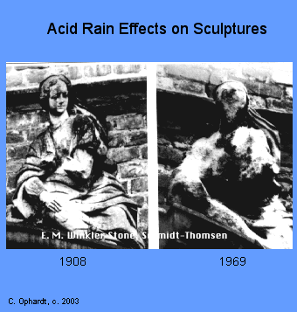
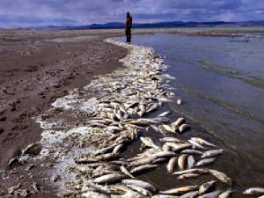
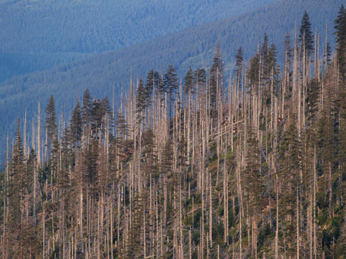
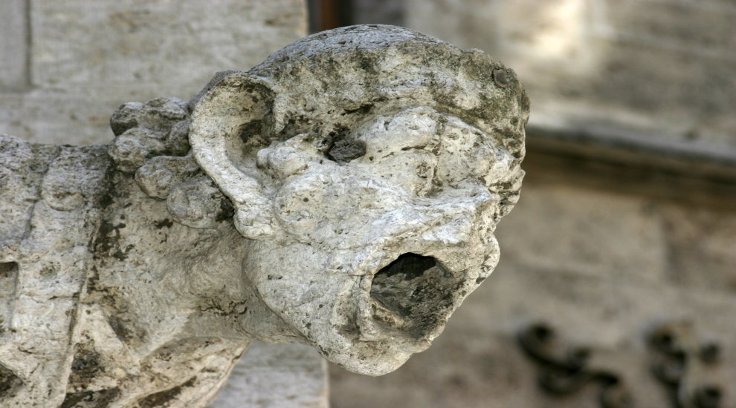

Slide 8
Humans on AR
There are many other man-made causes of acid rain.
Aerosols (also deplete the ozone layer!)
Chloroflurocarbons (found in refrigerants, hairsprays, and spray paint)
Burning things
Industrial products
Overfarming

Slide 9
Activity
What can we do to help prevent acid rain?
Write 2 paragraphs (5 sent/para min!) explaining your proposed method.

