Slide 1
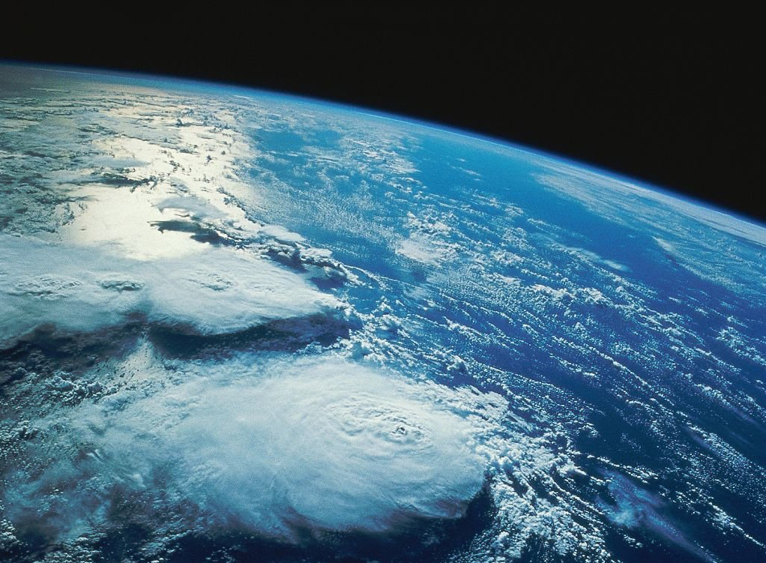
Atmosphere

Slide 2
Key Atmospheric Gases
The atmosphere is 99% composed of 2 gases:
Nitrogen (N) = 78%
Oxygen (O) = 21%
There are several other gases that make up the remainder:
H₂O Vapor = 0 – 4%
Argon = .93%
CO₂ = .03 %
.01% = Neon, Helium, Methane, Krypton, Hydrogen, Oxone, Xenon

Slide 3
Small but Important
The levels of CO₂ and H₂O in the atmosphere are small, but very significant.
They both regulate the amount of energy the atmosphere absorbs.
When water changes forms (ice, water, vapor), it releases or absorbs heat.
This affects atmospheric motions that create weather and climate.

Slide 4
OZONE
Known by the symbol O₃.
It exists in small amounts well above Earth’s surface.
Controls the amount of ultraviolet radiation reaching Earth’s surface.

Slide 5
Layers of the Atmosphere
Troposphere →
Stratosphere →
Mesosphere →
Thermosphere →
Exosphere →
SPACE

Slide 6
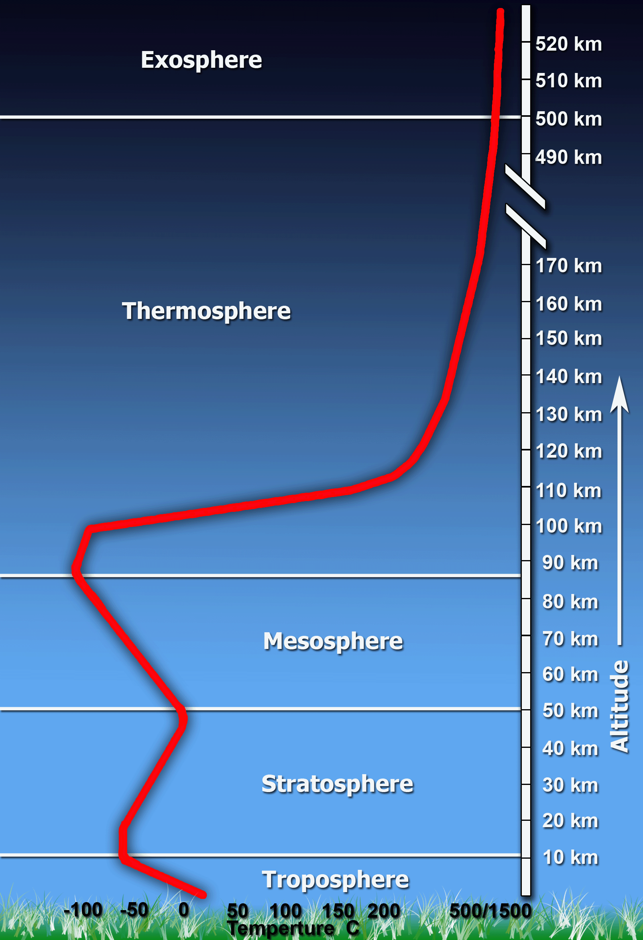

Slide 7
Troposphere
Contains most of the atmosphere (including H₂O).
Most weather occurs here.
Characterized by a drop in temperature from top to bottom.
Top layer is called the tropopause.
This is where the gradual decrease in temp. stops.

Slide 8
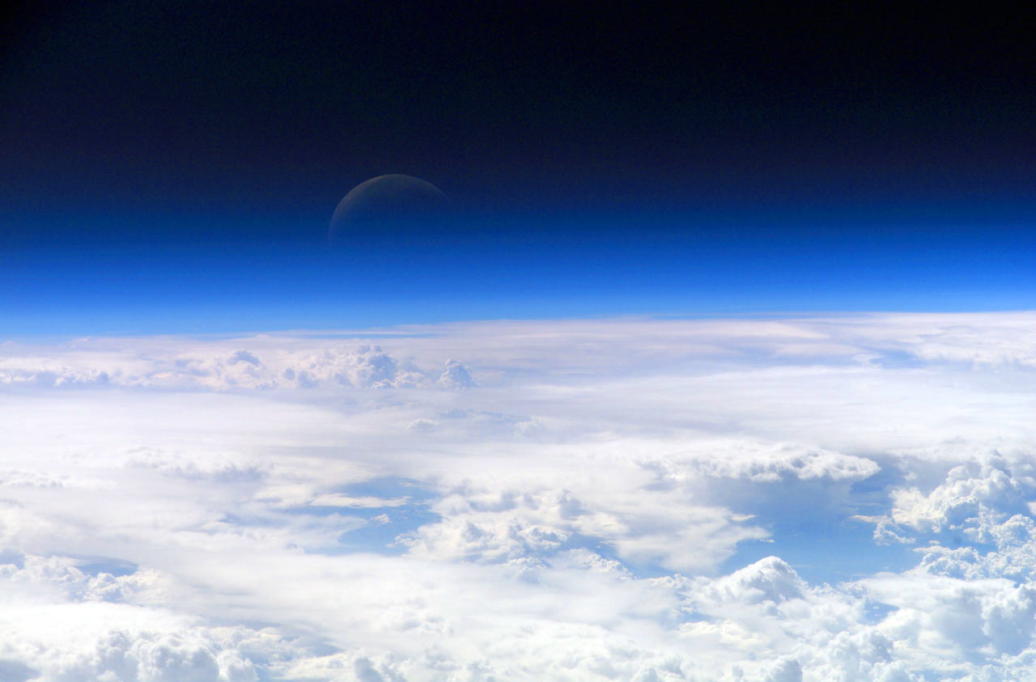
Stratosphere
Primarily composed of concentrated ozone.
Heated from all the ultraviolet radiation absorption (up to ~surface temperature).
Ends at the stratopause.
Most planes fly here
to avoid storms.

Slide 9
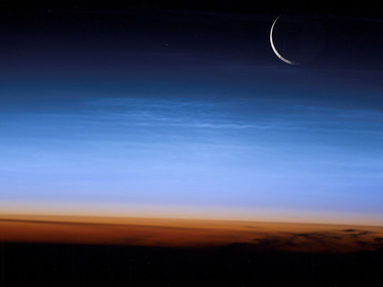
Mesosphere
No concentrated ozone, so temperature plummets again to about -80ºC (-112ºF).
Top is called the mesopause.

Slide 10
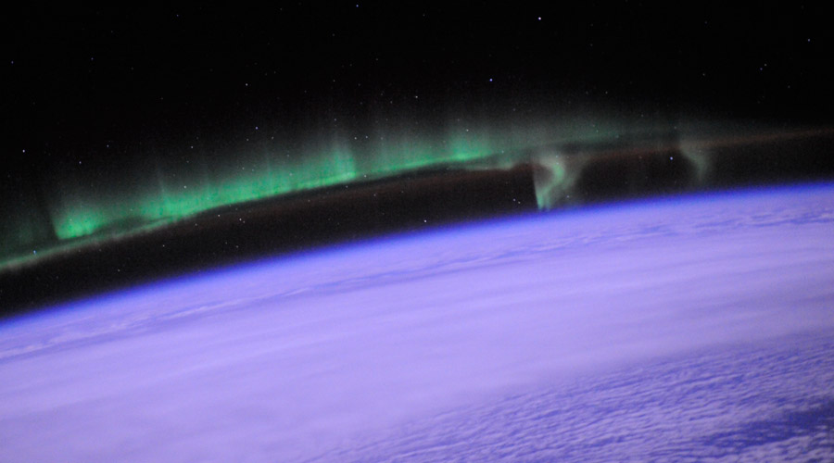
Thermosphere
Contains little of atmosphere’s mass.
Massive increase in temperature!
Up to 1000ºC (1832ºF)!
However, molecules that make up air are so sparse it would not seem warm.

Slide 11
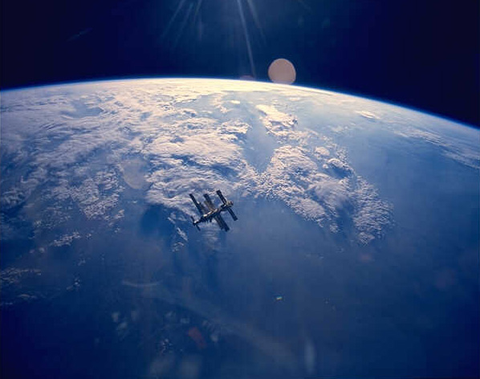
Exosphere
Outermost layer of Earth’s atmosphere.
Gases like helium and hydrogen are found there.
After this is outer space, but there is no clear boundary.

Slide 12
Radiation
Transfer of energy through space by visible light, ultraviolet radiation, and other forms of electromagnetic waves.
Warms the Earth’s surface.

Slide 13
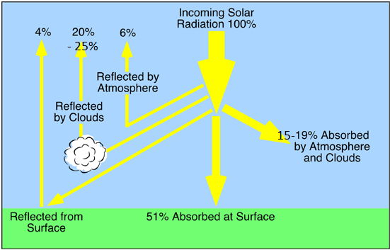

Slide 14
Energy Movement
Conduction – transfer of energy that occurs when molecules collide.
Heats a few centimeters of air near the surface.
Convection – transfer of energy by the flow of a heated surface.
Cold air pushes warm air up, making a convection current.

Slide 16
Clouds
Clouds form when:
Warm, moist air is forced to rise over a mountain
Known as orographic lifting
Two air masses of different temperatures meet
Latent heat – energy stored in water vapor (clouds!)

Slide 17
Clouds
Height
Cirro: high clouds
Alto: middle clouds
Strato: low clouds
Shape
Cirrus: whispy and stringy
Cumulus: puffy/fluffy
Stratus: layer/sheet of cloud
Nimbus: low, gray rain cloud

Slide 18
