Slide 1
Climate

Slide 2
What is it?
Climate = weather over a long time, months and years!
Köeppen Climate Classification
Classifies according to temperature, precipitation, and vegetation.

Slide 3
5 Types
Tropical – high temp and precip.
Normally by equator
Dry - ~30% of Earth’s landmass, largest climate zone
Mild/Temperate – warm/wet summer, cold/dry winter
Continental – rapid and violent weather changes
Polar – Coldest, average temp. <10ºC.

Slide 4
What can affect climate?
El Niño
Volcanoes
CO2
Orbital shift
The Sun

Slide 5
El Nino
Associated with a band of warm ocean water in the usually-cold Pacific.
Causes pressure changes across those areas bordering the Pacific ocean (a lot of places!)
Leads to warmer air and weaker trade winds
Water is nutrient-poor, and many animals die
Reverses the usual climate of an affected area.

Slide 6
Greenhouse Effect
The heating of Earth’s surface caused by certain gases in atmos.
Water vapor, methane, CO₂
CO2 accounts for 82%.
As a result it is the main focus of public discussion
Increase in CO₂ from cars, people, deforestation.
https://www.youtube.com/watch?v=BPJJM_hCFj0

Slide 7
Heat Islands
A microclimate usually found in areas of large-scale urbanization
Microclimate = a small, isolated climate inside another, larger climate

Slide 8
Ocean Acidification
As CO2 levels increase, the pH of the oceans are decreasing.
Causes major damage to wildlife
Massive algae blooms in salt water
Damages fish brains and causes erratic behavior
Massive damage to coral reefs
http://apps.seattletimes.com/reports/sea-change/2013/sep/11/pacific-ocean-perilous-turn-overview/

Slide 9
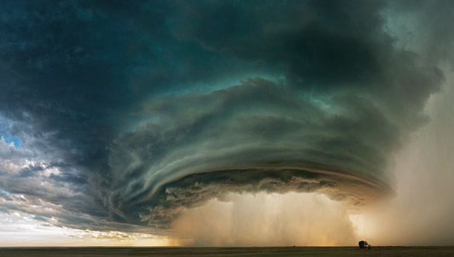
Extreme Weather

Slide 10
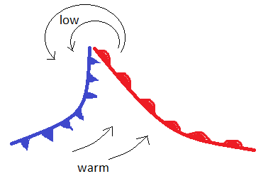
Mixing of Air Masses
Can form tornadoes, hurricanes, tropical storms, etc.

Slide 11
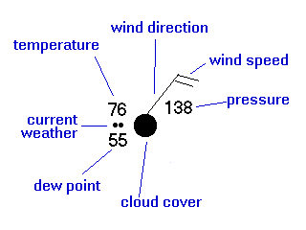
Weather Symbols

Slide 12
Pressure and Weather
Rising Pressure = good weather
Hard for clouds to form with air sinking
Falling pressure = imminent storm
Warm air is rising, and starting to spin!

Slide 13
Tornadoes
Violent, whirling column of air in contact with ground.
Classified according to Fujita scale
Developed by Japanese tornado researcher Dr. Theodore Fujita.
Classified according to path of destruction, wind speed, and duration.

Slide 14
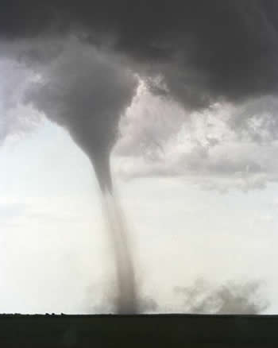
Weak Tornadoes F0 and F1
80% of all tornadoes
Path up to 3 miles
60-115 mph
1-10 minutes

Slide 15
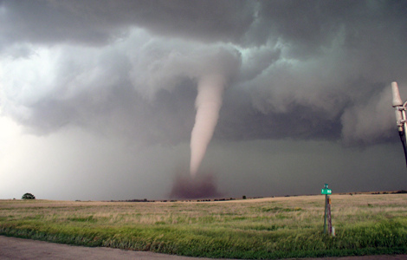
Strong Tornadoes F2 and F3
19% of all tornadoes
Path 15+ miles
110-205mph
20+ minutes
https://www.youtube.com/watch?v=WMsUQGL7j5Q

Slide 16
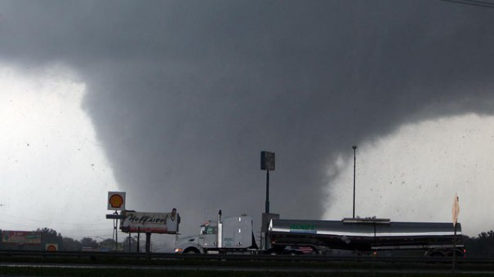
Violent Tornadoes F4 and F5
1% of all tornadoes
Path 50+ miles
200+ mph
(even up to 500mph)
1+ hour
https://www.youtube.com/watch?v=W19qa-AK8Dk

Slide 17
Tornado Safety
Get to underground shelter.
Stay away from windows.
Get out of cars.
If caught outside, lie flat in ditch/depression.

Slide 18
Hurricanes
Also called Tropical Cyclones/Cyclone/Typhoon
Need two conditions:
Lots of warm ocean water
A disturbance to lift warm air and keep it rising
The Coriolis effect causes moving air to turn, increasing in speed as energy is released through condensation.
http://video.nationalgeographic.com/video/101-videos/hurricanes-101

Slide 19
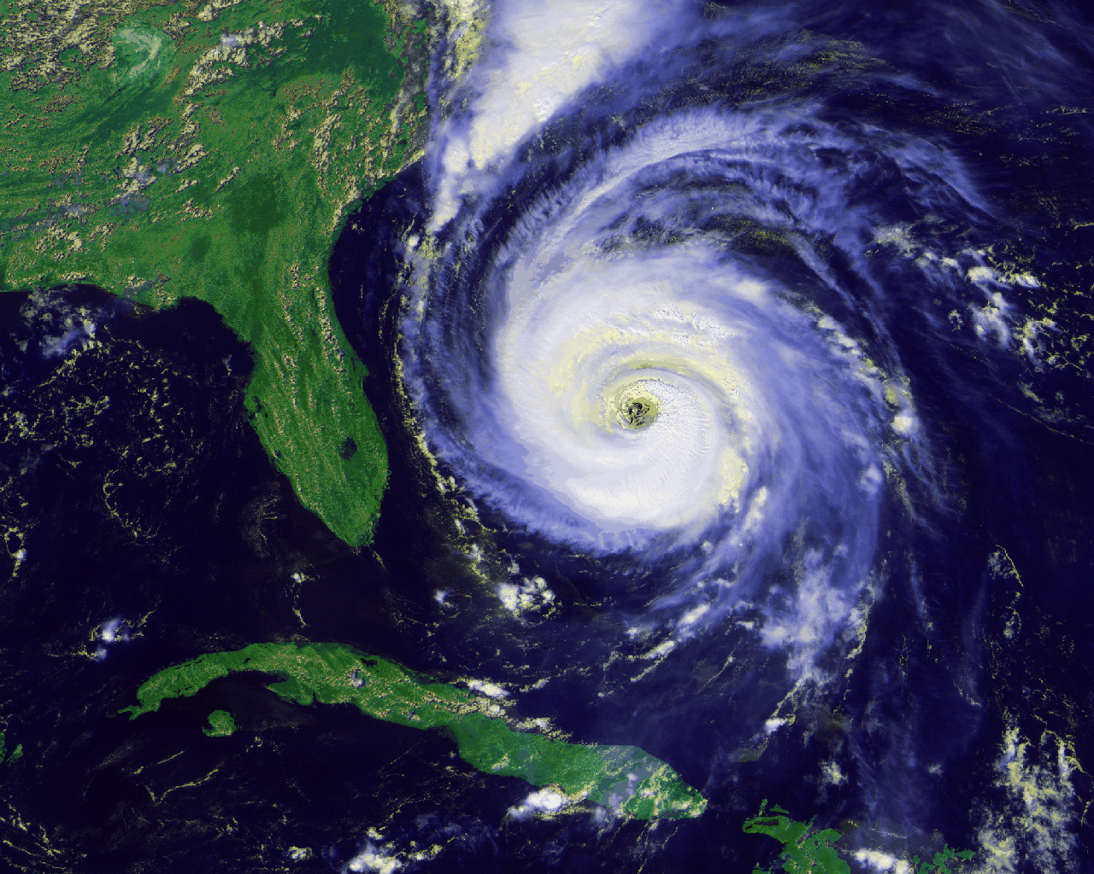

Slide 20
Saffir-Simpson Hurricane Scale
Scale Number | Wind Speed (mph) | Damage
1 | 74-95 | Minimal
2 | 96-110 | Moderate
3 | 111-130 | Extensive
4 | 131-155 | Extreme
5 | >155 | Catastrophic
http://video.nationalgeographic.com/video/news/katrina-mississippi-destruction-vin

Slide 21
Cyclone Safety
Unplug appliances.
Turn off propane tanks.
Prepare water supplies.
Stay away from doors/windows.
Close all interior doors and brace external ones.
Go to interior first-floor room (bathroom/closet).
Lie under table/study object.

Slide 22
Activity
Get into small groups (max of 3)
Each group will be given an article of a historical tornado or hurricane.
Create a short presentation (words and poster) to show your storm’s:
Location
Date
Level on Scale
Costliness
Description of storm and its damage.
Storm’s Impact: technology, political, forecasting, etc.

