Slide 1
Human Effects on Lithosphere

Slide 2
Urbanization
The spreading of urban development into natural habitat.
Results in loss of forest/habitat, increase of disease, increase of pollution

Slide 3
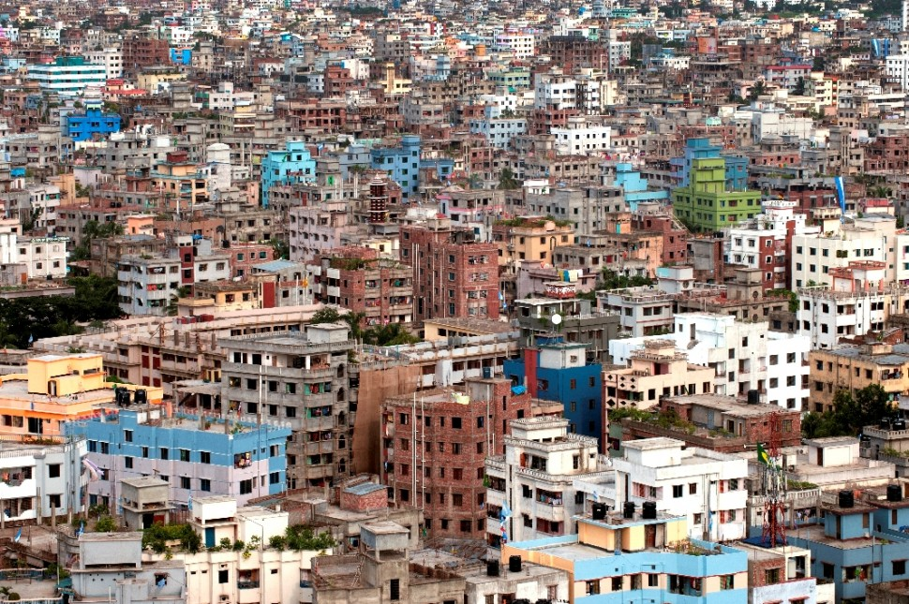
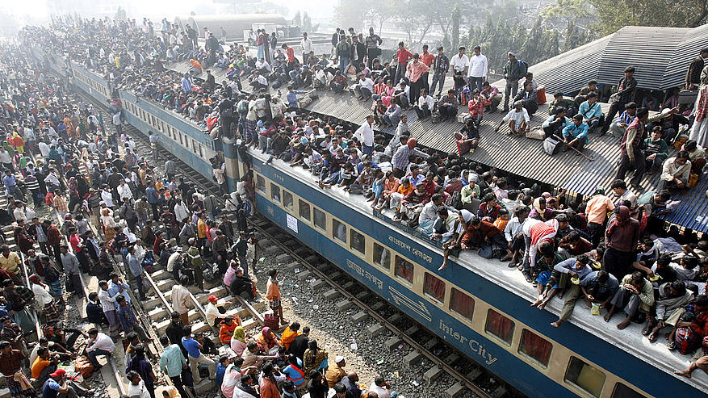
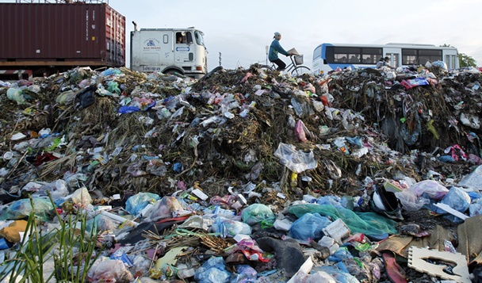
http://video.ft.com/2922152208001/Smog-blankets-Shanghai/World

Slide 4
Mining
Surface mining – remove huge amounts of overlying soil and rock, completely changes landscape.
Underground mining – less disruptive to surface, but water seeping through can dissolve toxic metals into water systems.
Reclamation – restoring land to original contours and replanting vegetation

Slide 5
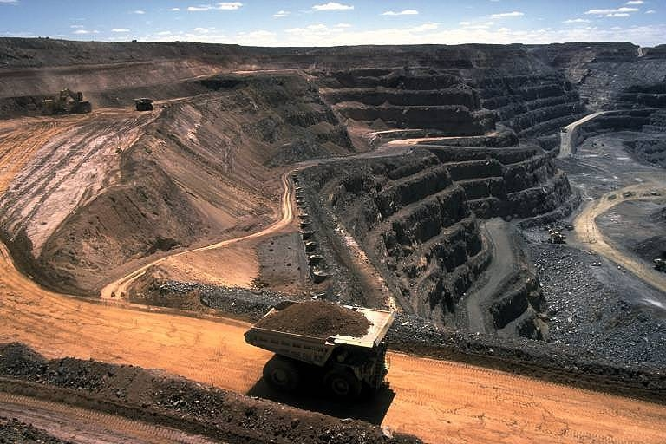
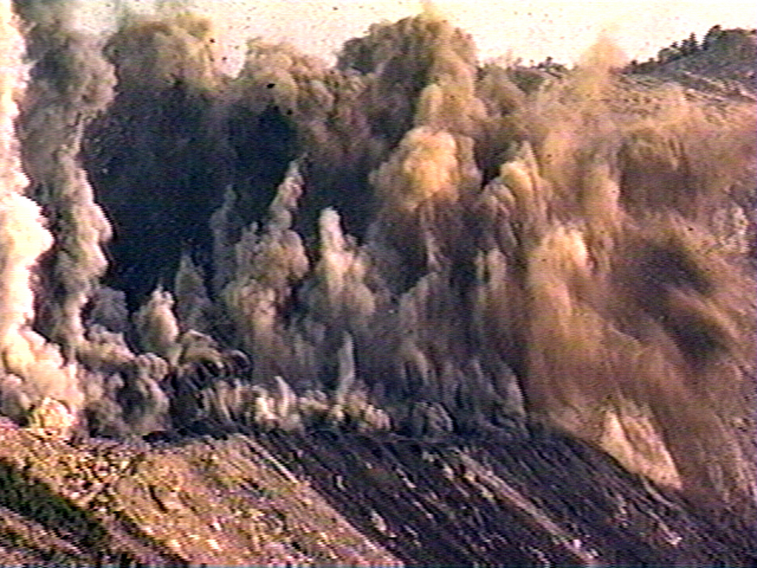
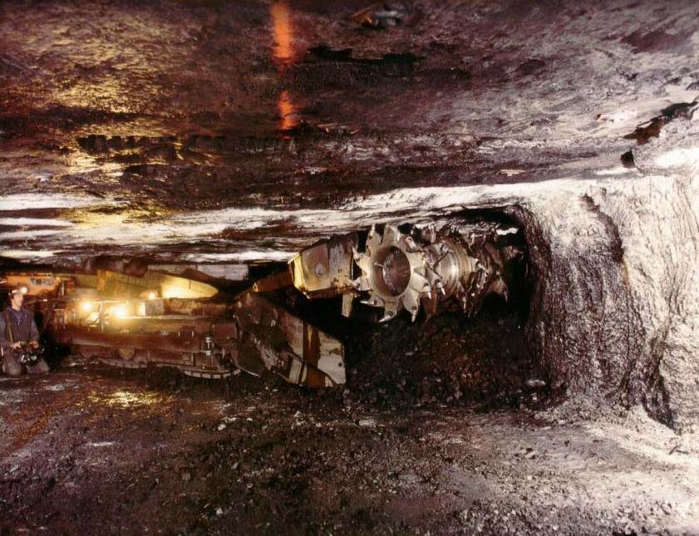
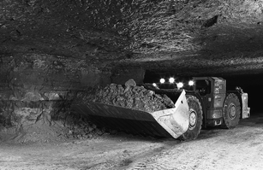

Slide 6
Agriculture
A spread in farmland had resulted in severe deforestation
Misuse and overuse of pesticides and herbicides
Carried into water systems to cause pollution
Causes extreme erosion, with topsoil taking thousands of years to replace

Slide 7
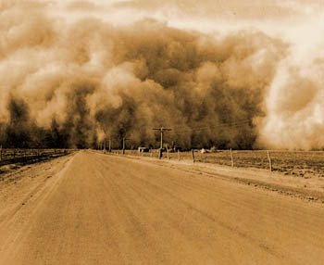
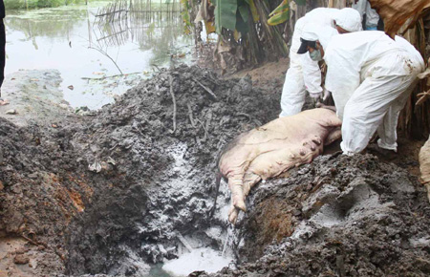
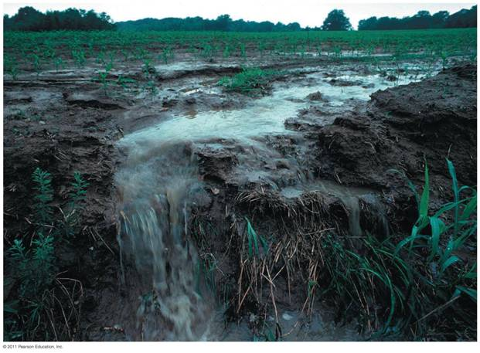
http://www.history.com/topics/dust-bowl/videos#america-black-blizzard
http://video.pbs.org/video/2247092322/
https://www.youtube.com/watch?v=GJxb7CY13uc

Slide 8
Deforestation
Destruction of forested land
Often involves clear-cutting: complete removal of trees.
Results in massive erosion, landslides, and clogging of nearby water systems.

Slide 9
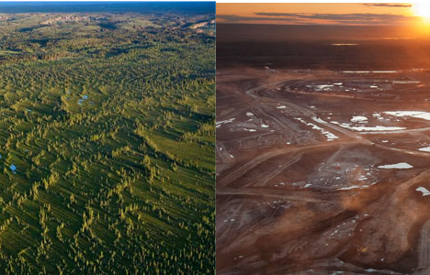
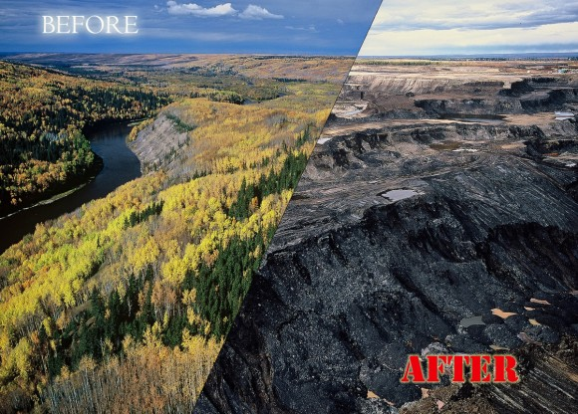
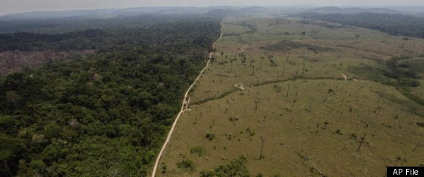

Slide 10
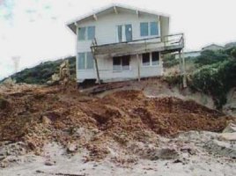
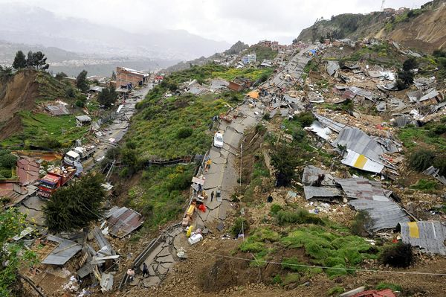
Shorelines and Mountainsides
Increased habitation on shorelines is resulting in rapid deterioration and erosion. Pollution continues to destroy natural wildlife and habitat.
Mountainsides are becoming continuously weaker with tree-removal and land clearing, resulting in disastrous landslides.

Slide 11
WHAT CAN WE DO?
Reclamation for mining
Bioremediation – use of bacteria and other organisms to clean up toxins
Landfills to properly dispose of waste
Protective barriers to rebuild shorelines and mountains, and stabilize remaining areas

Slide 12
Ways We Get Energy

Slide 13
Traditional Energy
Harvesting
Taken from surface
Crops, wood, feces, peat
Peat: layer of soggy Earth made of decomposing organic materials
Mining
Removing materials below surface
Coal* and Uranium
Drilling
Long narrow tube into Earth’s crust
Natural gas*, oil*, petroleum*
*Fossil fuel
energy source formed over thousands of years

Slide 14
Types of Alternate Energy
Solar
Water
Geothermal
Wind
Nuclear

Slide 15
Solar Power
From sun
Use panels

Slide 16
Water
Water spins turbines which run generators
Generators produce electricity = Hydroelectric!

Slide 17
Geothermal
From Earth’s internal heat
Harvest steam and hot water

Slide 18
Wind
Wind cranks turbines which produce electricity
All of the country’s
energy needs could
be met if we set up
wind farms in
N. and S. Dakota
and Texas!

Slide 19
Nuclear
Breaking atoms and using radioactive elements
Makes the most energy at the greatest risk
www.youtube.com/watch?v=rvAJ_u3Q0Hw
Chernobyl was a nuclear power plant that exploded in 1986. It send deadly radioactive materials into the air. Within days the radioactive cloud spread all across Europe and western Asia.
The radioactivity caused a large increase in cancer and mutations
The video has some footage from the scene

Slide 22
Campaign
Working with a partner, devise an advertising campaign that lets people in the US know about the harmful effects of one of the topics covered.
Elements of the campaign:
Think of a catchphrase
Pick a celebrity spokesperson
Decide where will you advertise and why?
Make an advertisement
For background information, provide
Main reasons
Effects of activity
Possible alternatives

Slide 23
Letter to the Public
What the problem is
What should be done
Recommended course of action

