Slide 1
Traditional vs Sustainable Agriculture

Slide 2
NC’s Main Resources
Timber – 180 species of trees
Minerals – clay, stone, tungsten, feldspar, mica, lithium
Agriculture – corn, cotton, tobacco, X-Mas trees, pigs, cattle

Slide 3
What is traditional agriculture?
Usually it is defined as farming that is more permanent in its impact.
Uses:
fertilizers and pesticides
The same fields over and over again
Fossil fuels that increases the greenhouse effect

Slide 4
What is sustainable agriculture?
Usually defined as farming that has little negative impact.
Uses:
No additives/chemicals, is ‘organic’
Rotates crops fields with nitrogen-fixing plants to restore soil health
Allow ‘natural’ pest and plant control such as animals and native bacteria

Slide 5
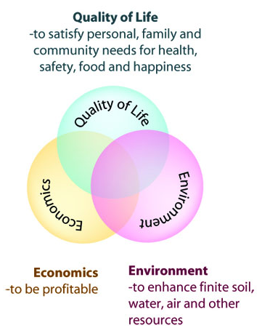
Sustainable Agriculture

Slide 6
Developing sustainable agriculture systems means...
Looking at the farming system as a whole Finding site-specific solutions Preserving options Staying open to new ideas
https://www.youtube.com/watch?v=7TRI7yeeYQQ

Slide 7
Today’s Assignment
Answer/Complete the following:
Create a chart to show the pros and cons of conventional and sustainable agriculture.
What are the future impacts of both types of agriculture?
Evaluate which agricultural product you would prefer in terms of:
Cost -- Quality
Distance traveled -- Amount of Handling
Price -- Days from harvest

