Slide 1
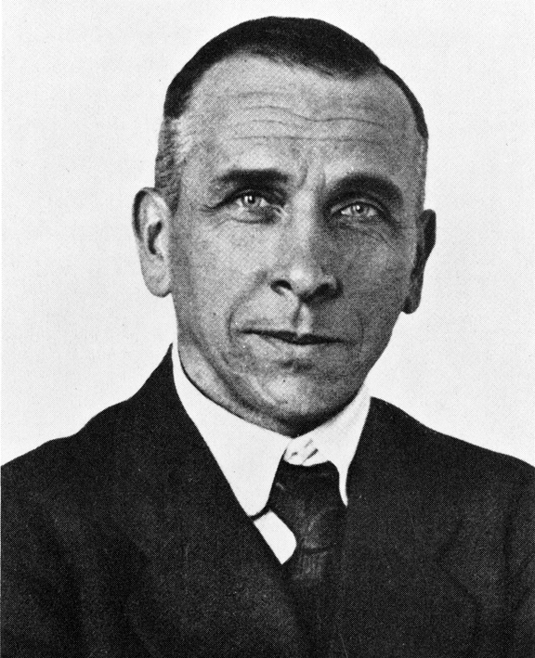
Father of Tectonics
Alfred Wegener
German scientist
Proposed theory of continental drift and tectonics

Slide 2
Volcanoes Around the World
Krakatoa – Indonesia
Mt Vesuvius – Italy
Mt. St. Helens – Washington
During times of crisis, how do people usually react???

Slide 3
Landslides
Flow of earth material downhill
Main cause: earthquakes and volcanoes
Lahar is a type of landslide
http://www.yo utube.com/watch?v=kznwnpNTB6k
http://www.wimp.com/massivelandslide/

Slide 4
Sinkhole
Sudden, natural hole formed in earth
Normally involves limestone
2 sinkholes in Raleigh since 2010, several in eastern NC by coast
http://www.youtube.com/watch?v=wF3ncFY_sYo

Slide 5
Tsunami
Monstrous wave caused by underwater earthquake or volcano
Japan – 9.0 eq – 5th strongest recorded
Waves 98 ft high
About 16,000 deaths
Indonesia – 9.3 eq – 3rd strongest recorded
Waves 133 ft high
280,000 deaths
https://www.youtube.com/watch?v=TRDpTEjumdo
https://www.youtube.com/watch?v=MyTTrj4wKMU

